Slide 1
Events and Media

Slide 2
Previously, in IMM120
Motion video and objects
Questions?

Slide 3
Download Processing
From processing.org

Slide 4
Warm-Up
Digital Clock
text(“string”/number, x, y);
textSize(##);
textAlign(CENTER, CENTER);
p5.js reference
5:48:12
PM

Slide 5
Events

Slide 6
Events
Functions that run once when they are triggered.
mousePressed is triggered when the mouse is pressed in
Info in mouseX, mouseY
keyPressed is triggered when a key is pressed down
Info in key and keycode
key is the letter typed: “a”, “s”, “w”, “d”, “5”
Common keyCodes: UP_ARROW, DOWN_ARROW, etc., ENTER, ESCAPE, SPACE, SHIFT, DELETE, BACKSPACE, TAB

Slide 7
Writing an Event in p5.js
function mousePressed() {
ySpeed = -10;
}
function keyPressed() {
name = name + key;
}

Slide 8
Controlling Keys
var leftIsPressed = false;
function keyPressed() {
if (keyCode === LEFT_ARROW) {
leftIsPressed = true;
}
}
function keyReleased() {
if (keyCode === LEFT_ARROW) {
leftIsPressed = false;
}
}

Slide 9
Switching Modes
Notes:
Not a segue

Slide 10
Images
Questions and more downloads:
https://postimg.cc/gallery/2wrxm8h9w/

Slide 11
Images
Source image
Load image
Display image

Slide 12


Images
Source image (from a folder or postimage.org)
Load image
Display image

Slide 13
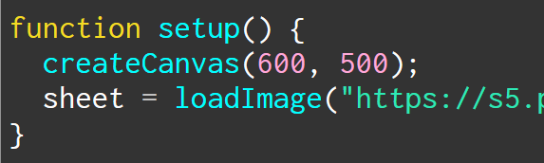
Images
Source image
Load image (make variable, loadImage)
Display image

Slide 14
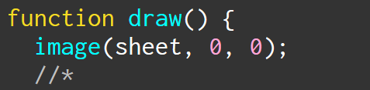
Images
Source image
Load image
Display image (use image command)
x y

Slide 15
Making Memes
Images, fancy text, input, boolean combination

Slide 16
https://postimg.org/gallery/2wrxm8h9w/
All the images for today’s class

Slide 17
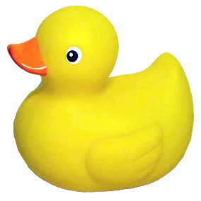
Making Memes
You’re turn to code!
Take the meme images from the gallery
https://postimg.org/gallery/2wrxm8h9w/
Display each meme
Make a mMODE for each meme
Switch from one to the next
I recommend function keyPressed() for this
Notes:
I split the penguin memes in half, don’t worry about it. There’s a good reason for it.

Slide 18



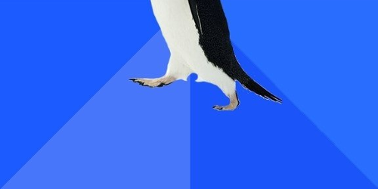
What About These?
Notes:
You may have noticed I split the penguin memes in half…
Make a mode for these real quick

Slide 19
Combining Boolean Ideas
We want to display the upper awesome penguin when:
AWESOME PENGUIN or AWKWARD->AWESOME PENGUIN
Strict boolean logic
AND for when both have to be true (You and I will be there)
OR for when either is true (You or I will be there)

Slide 20


Combining Boolean Ideas
AND → &&
OR → ||
Notes:
pipe

Slide 21
Combining Boolean Ideas
if (mode == mAWESOME || mode == mAWK_AWESOME) {

Slide 22
Combining Boolean Ideas
if (mode == mAWESOME || mode == mAWK_AWESOME) {
IF THIS IS TRUE OR THIS IS TRUE,
execute the contained code

Slide 23
Spritesheets
Animated images
Notes:
GIFs don’t work easily
Sprites are the way to go

Slide 24
https://www.piskelapp.com
A free, online spritesheet drawing

Slide 25
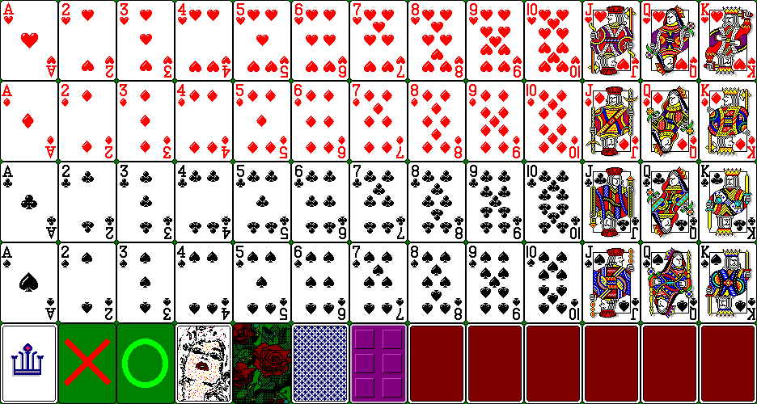

Slide 26
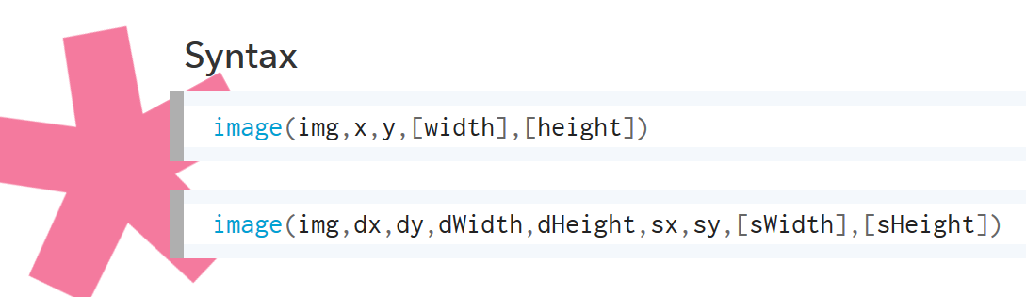

Slide 27
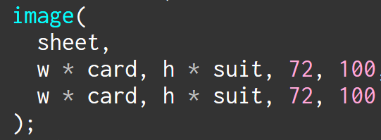

Slide 28
72 times the card you want
0 72 144 216 288 360 432
Notes:
Notice that we start at 0 here

Slide 29
0
100
200
300
100 times the suit you want
Notes:
Notice that we start at 0 here

Slide 30
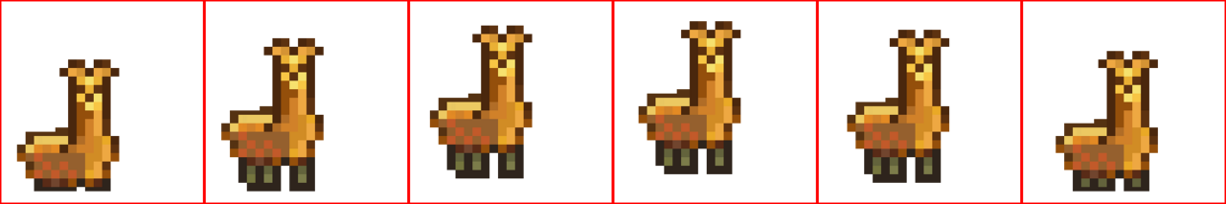

Slide 31
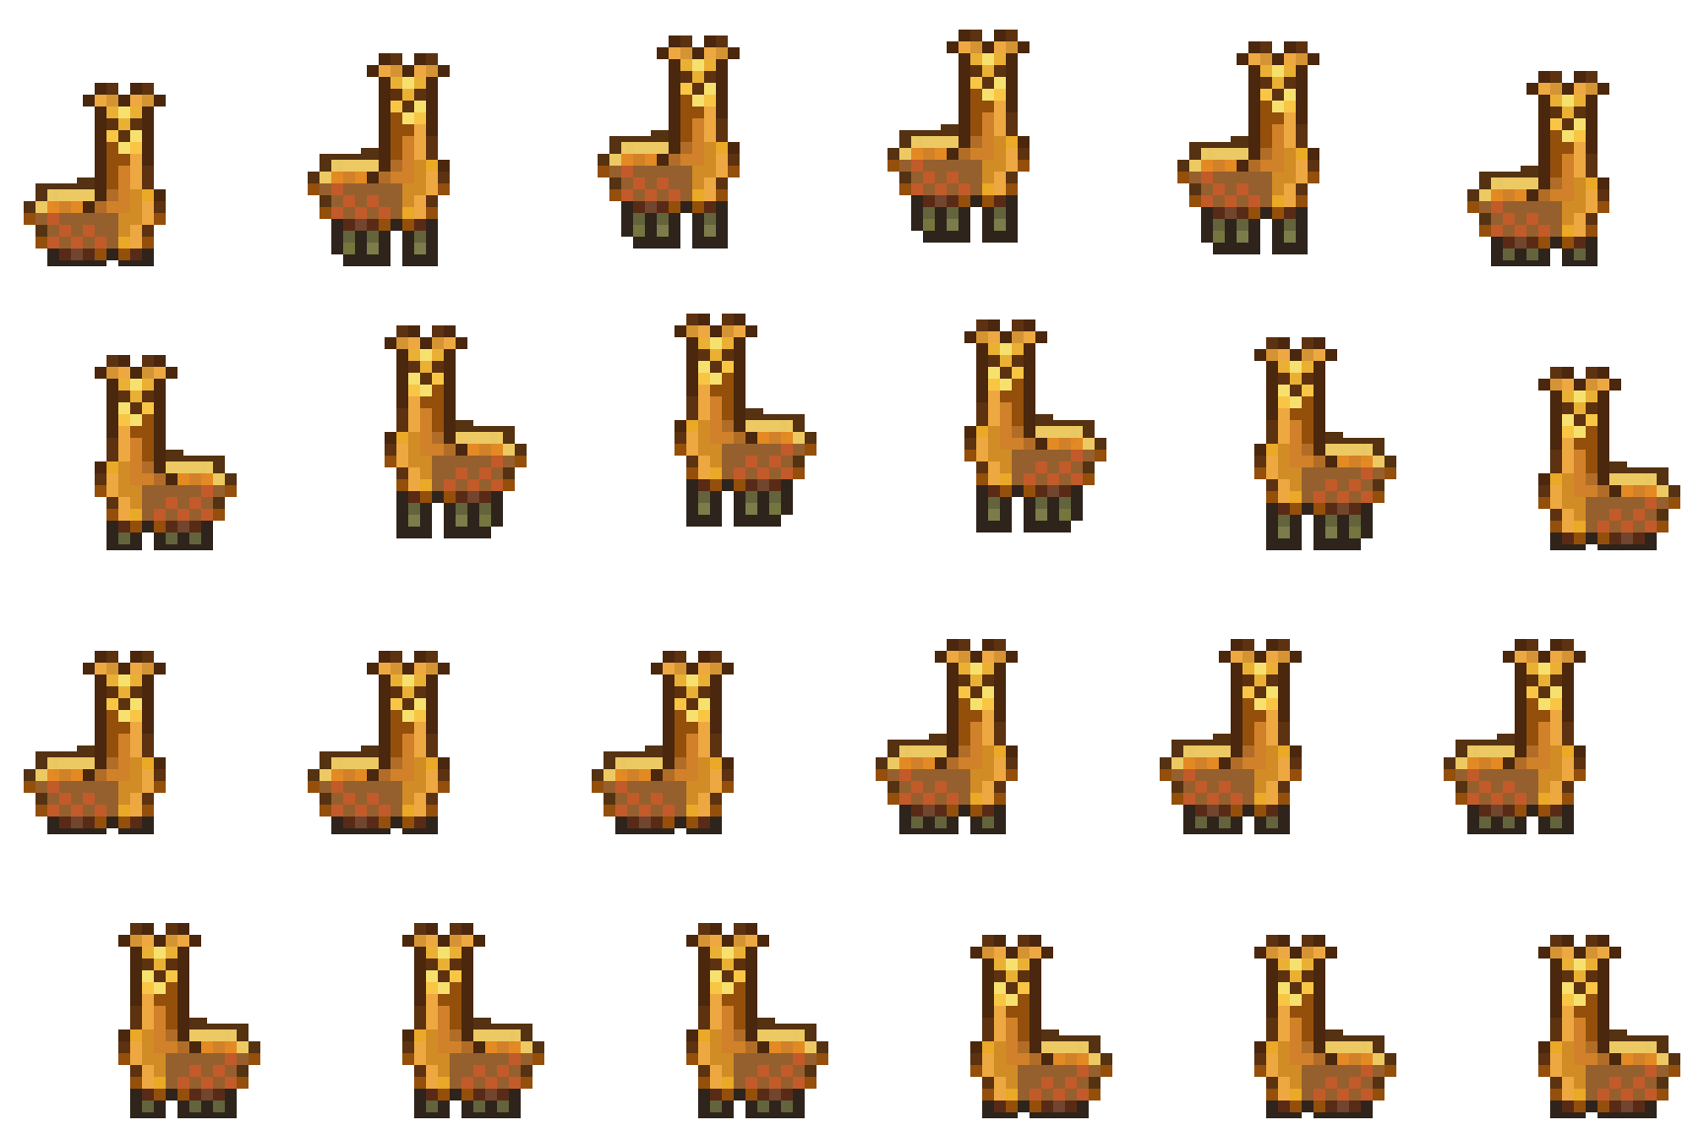

Slide 32
Bouncing right
Bouncing left
Standing right
Standing left

Slide 33
Sounds
Time to fire up Processing

Slide 34
Minute Survey

